Slide 1


Instagram Clone
Instagram Clone
Lecturer : Oum Saokosal
Presenters :
1.Lim Lyhak
2.Thy sobroney
3. Phom Pheakdey

Slide 2
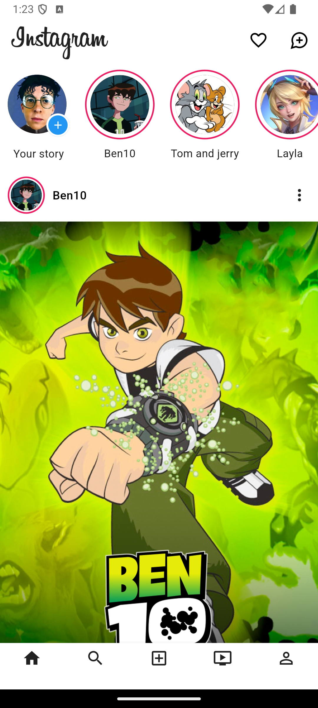
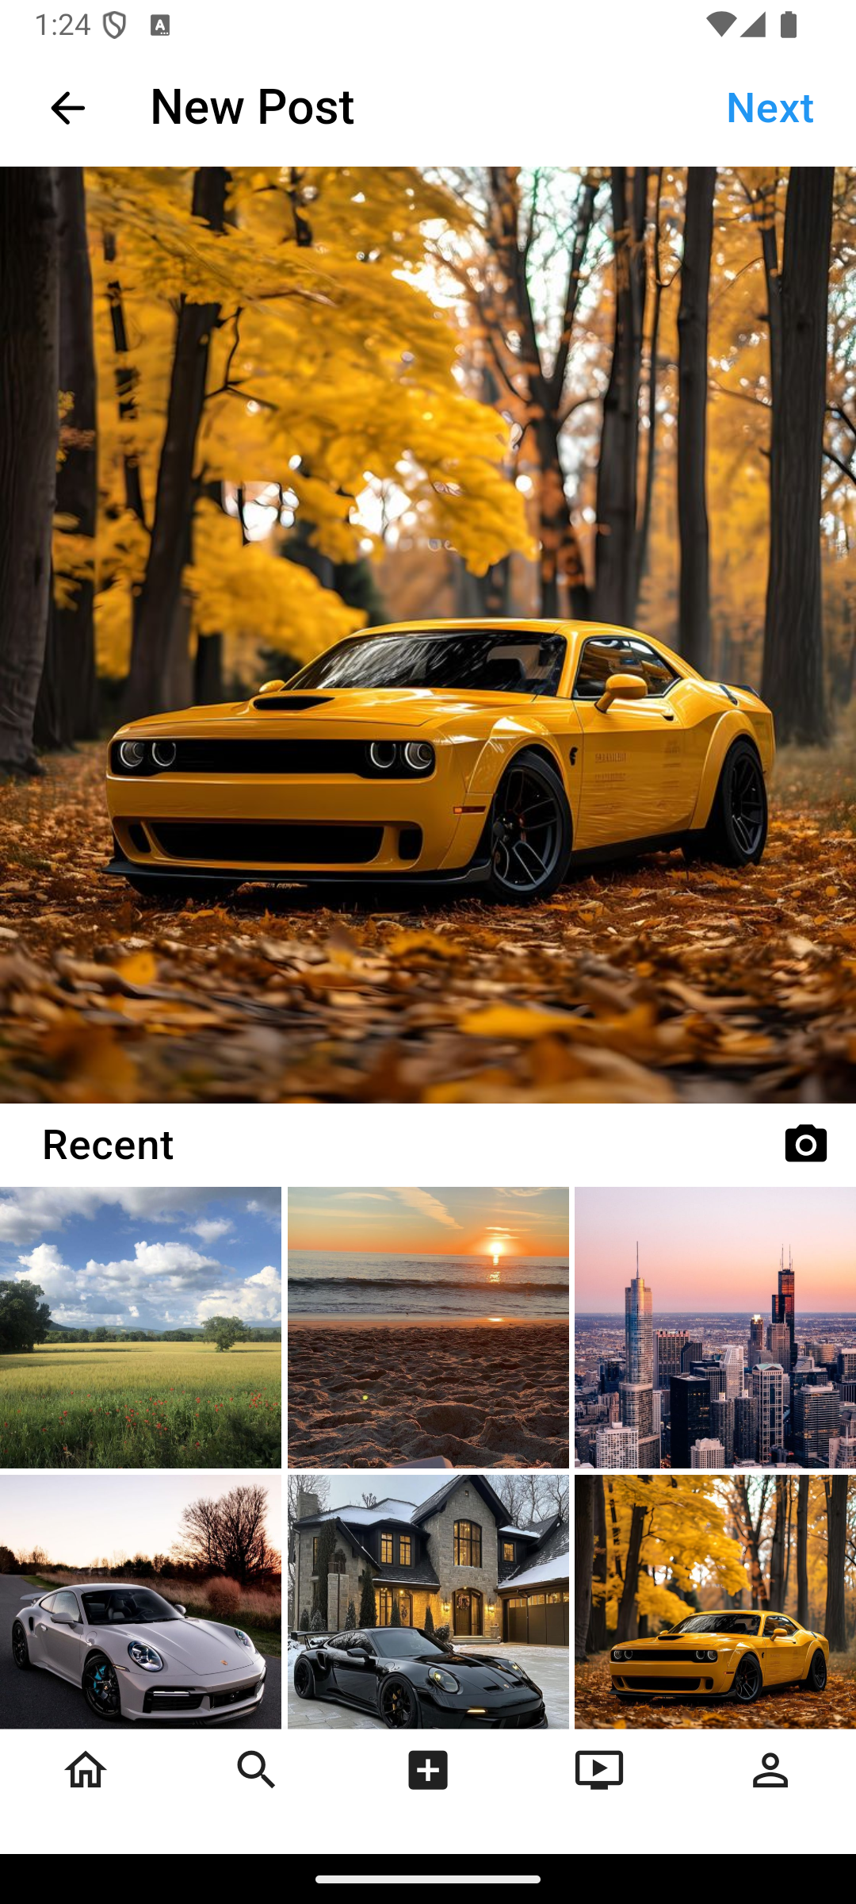
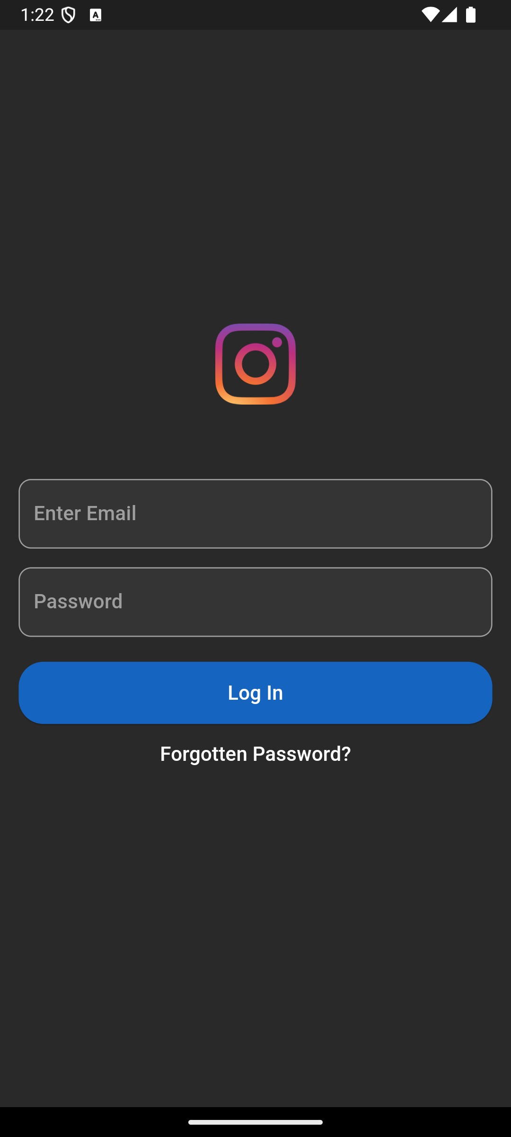
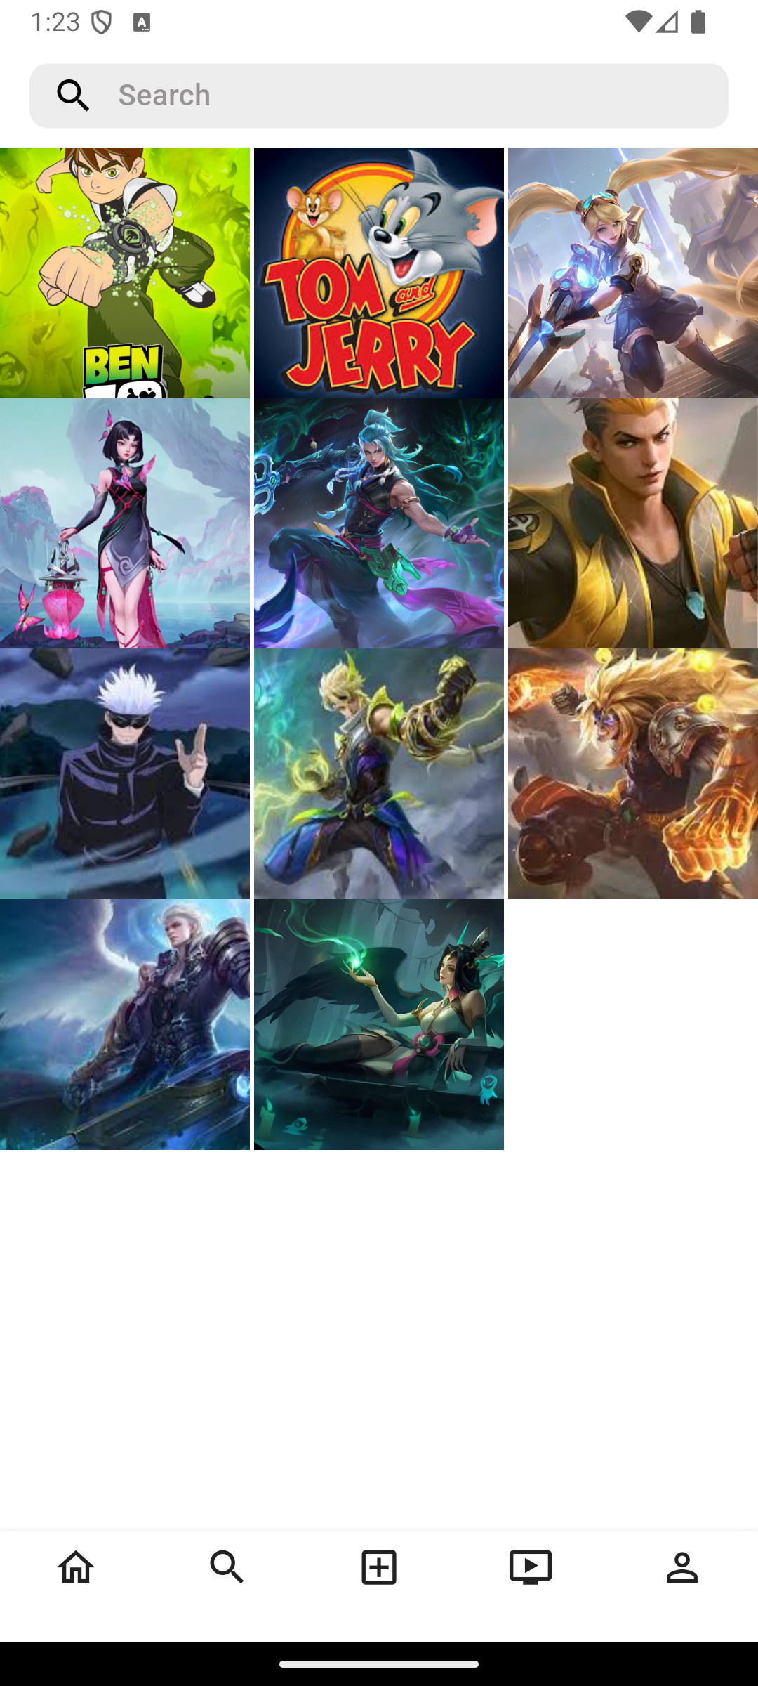
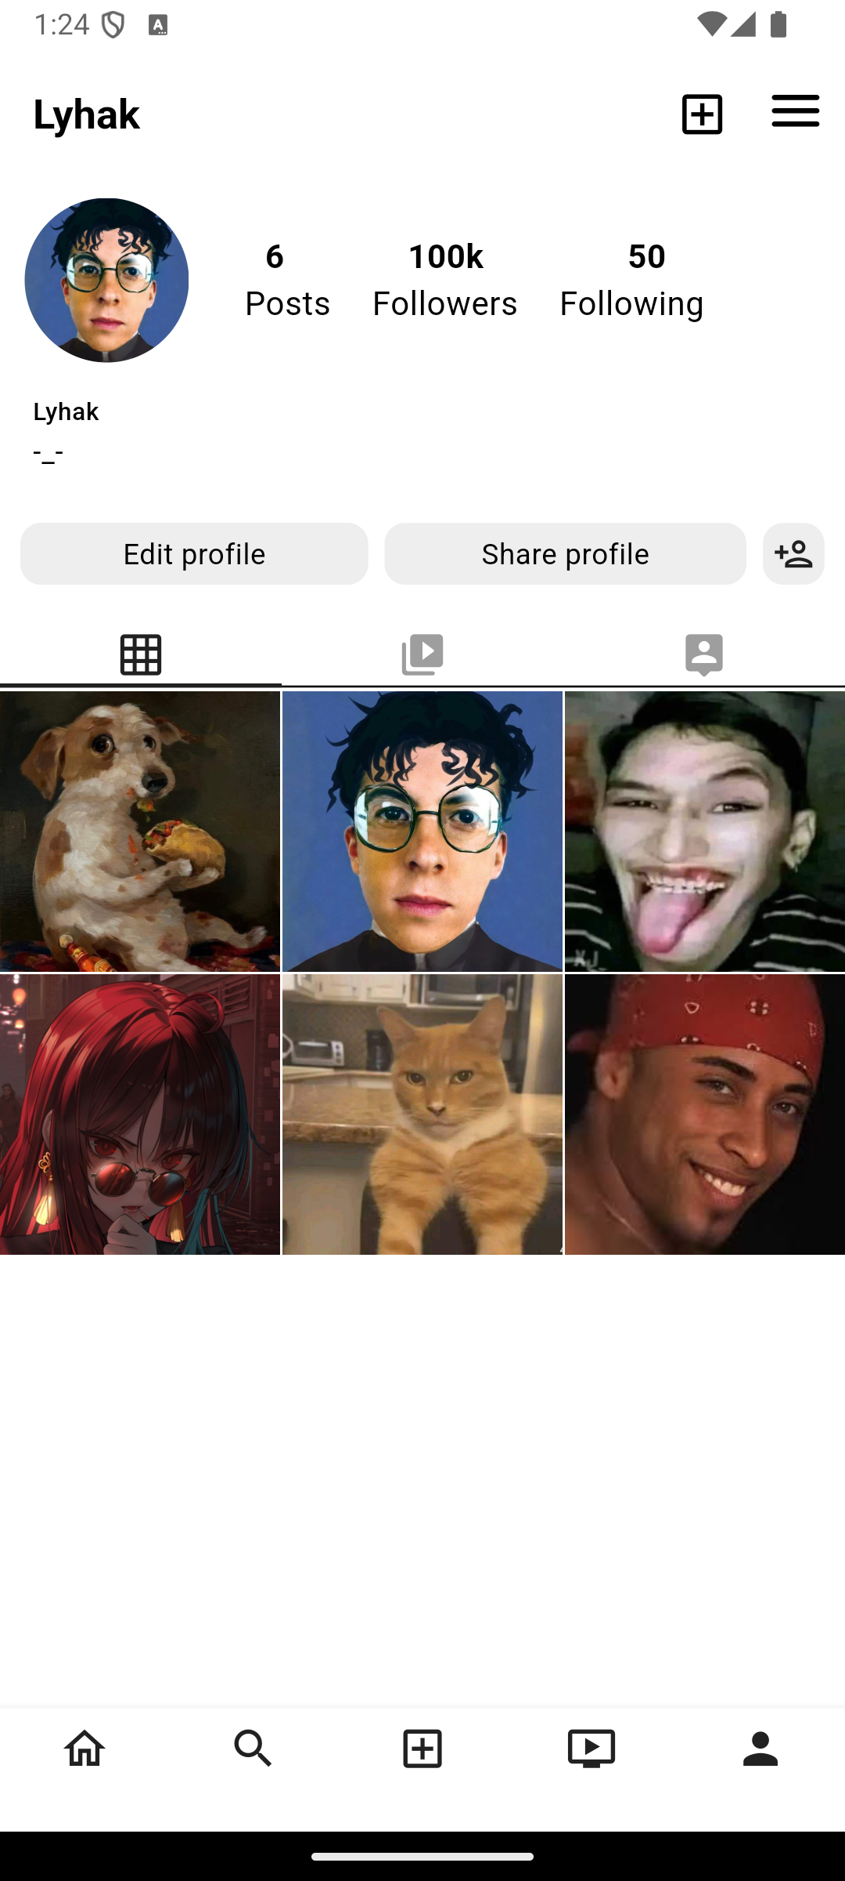
Cloned Screen
Instagram Clone

Slide 3
Instagram Cloned Screen
Login Screen
Technologies used
1.User Authentication: Secure login with email and password.
2.Responsive Design: Ensures usability across various screen sizes.
3Validation: Real-time feedback on incorrect or incomplete inputs (e.g.,login failed).

Slide 4
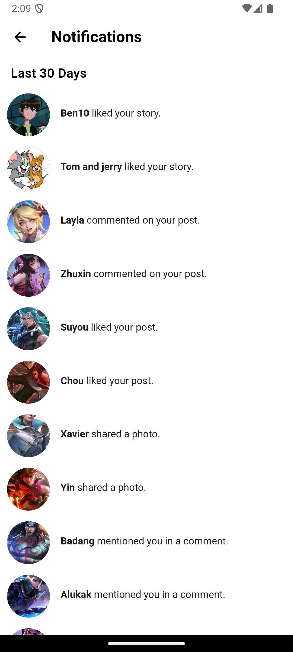
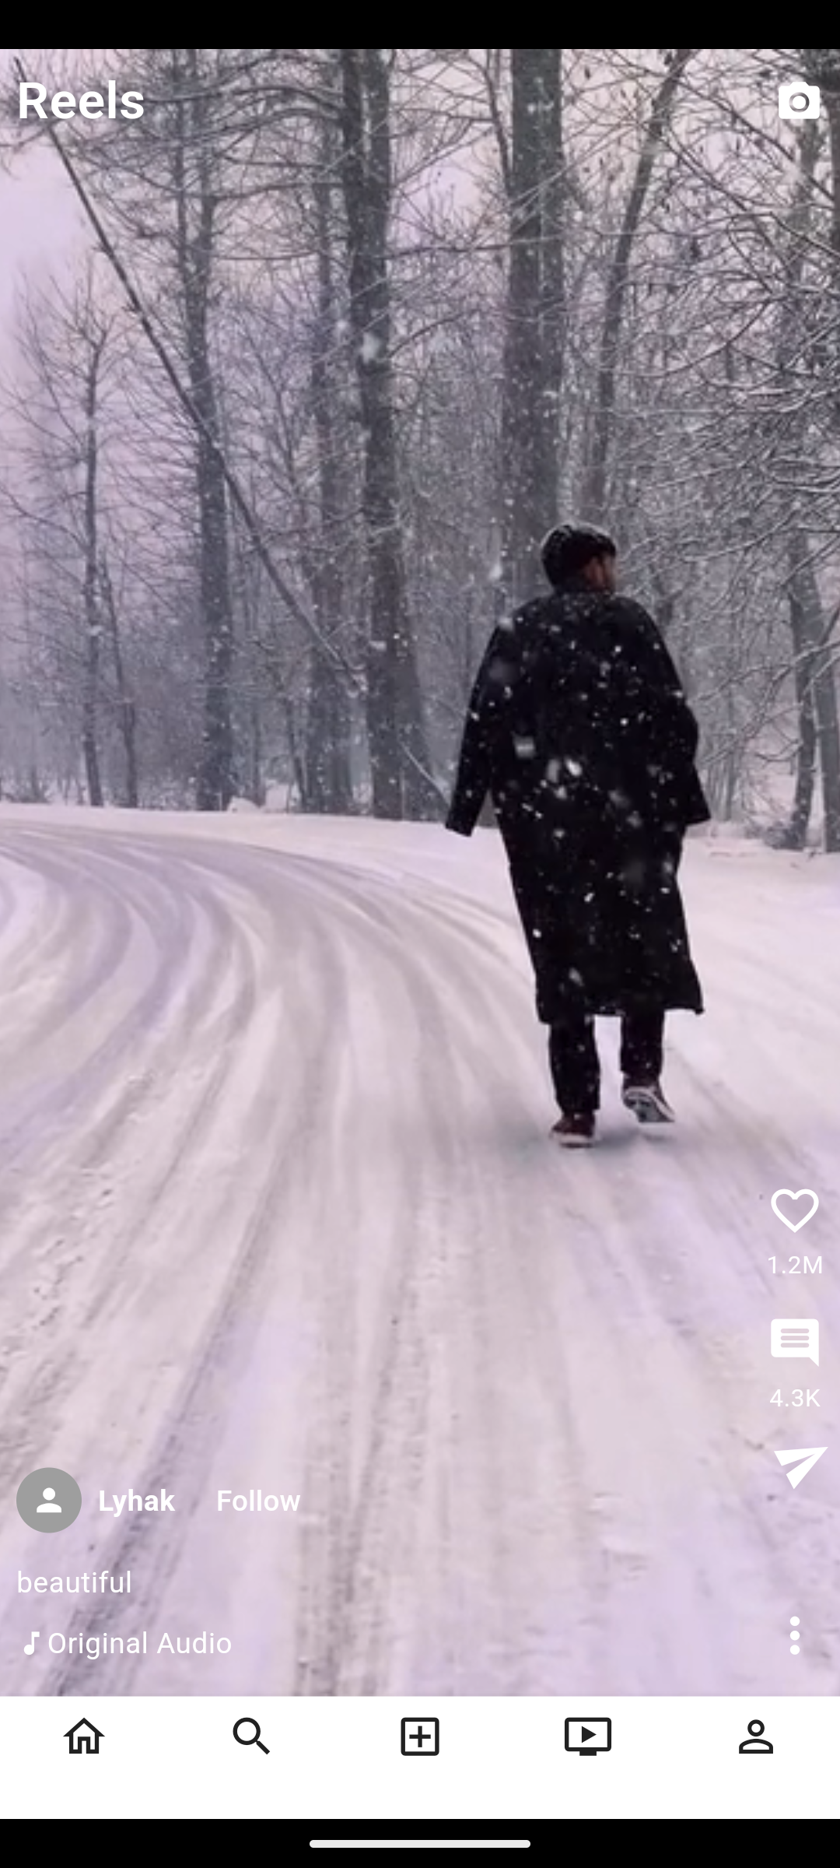
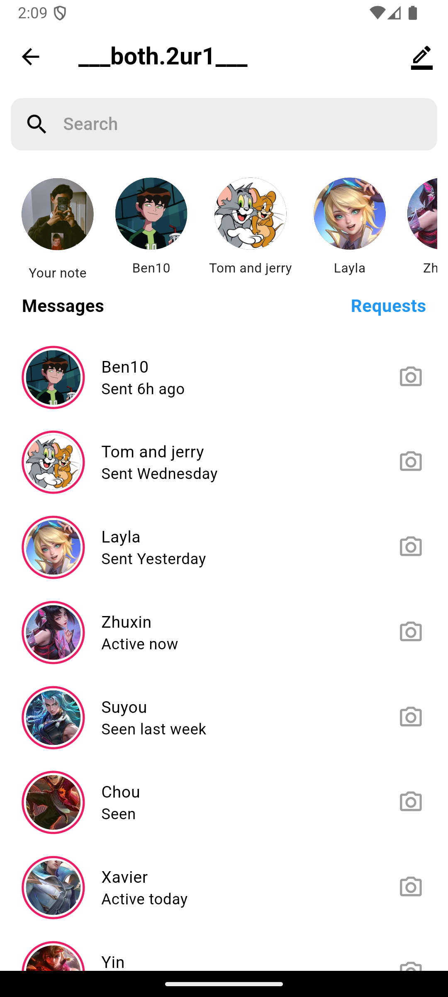
Cloned Screen
Login Screen
Home Screen
Technologies used
1.User Authentication: Secure login with email and password.
2.Responsive Design: Ensures usability across various screen sizes.
3.Validation: Real-time feedback on incorrect or incomplete inputs (e.g.,login failed).

Slide 5
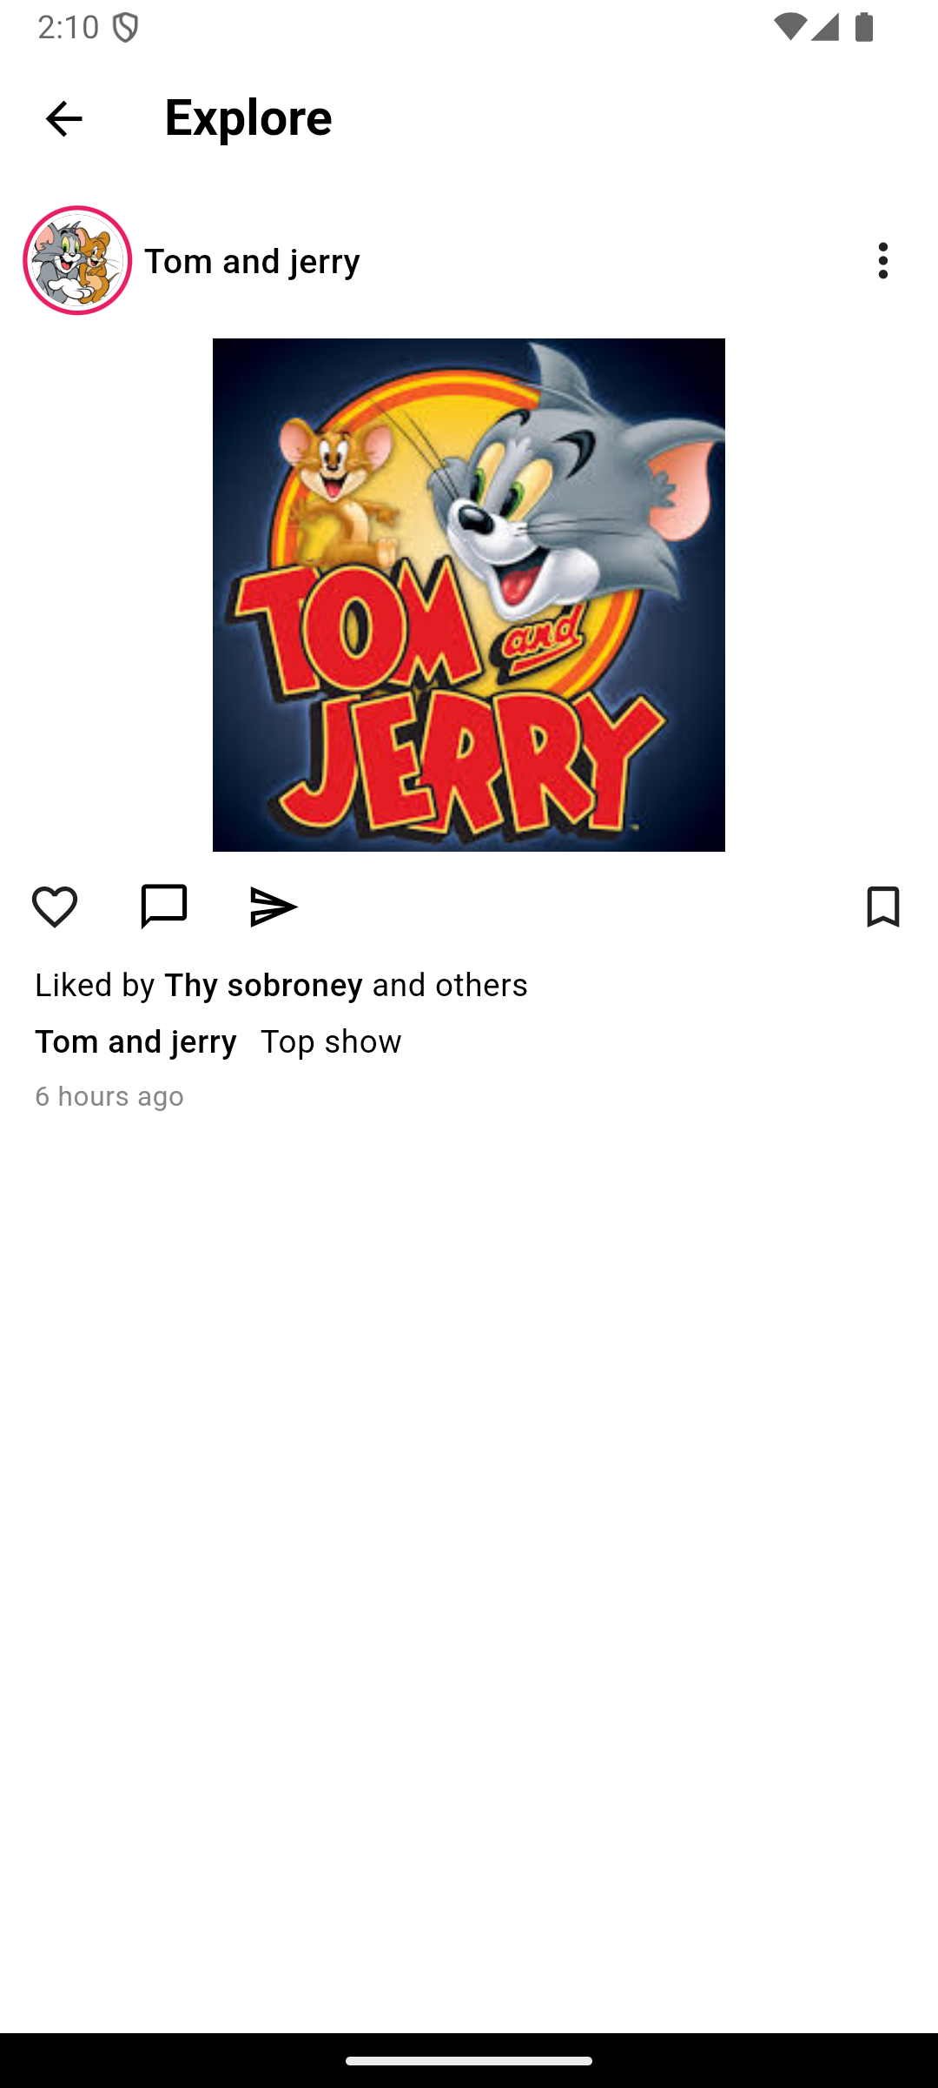
Login Screen
Home Screen
Search Screen

Slide 6
Add New Post
Search Screen

Slide 7
Home Screen
Add New Post
Search Screen

Slide 8
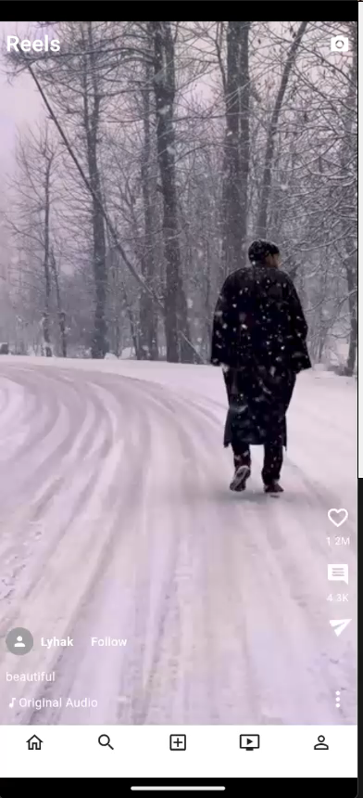
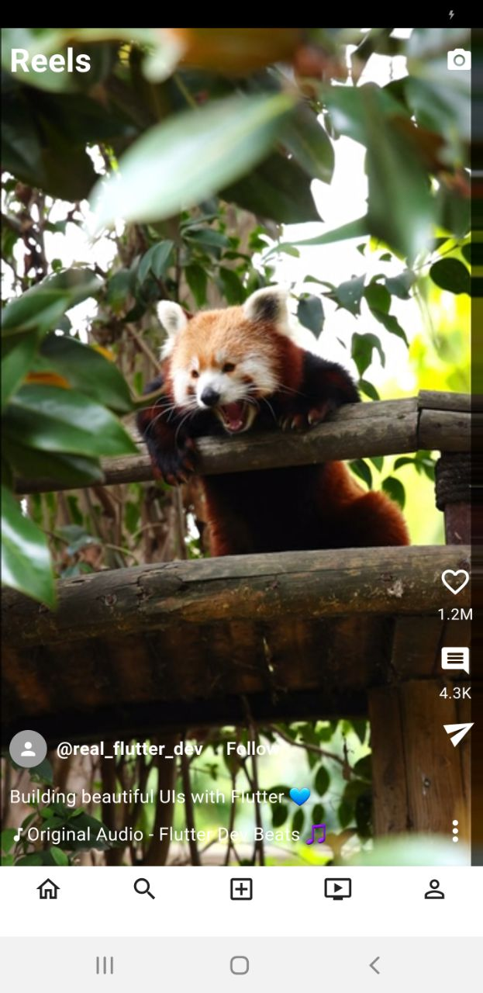
Reels Screen

Slide 9
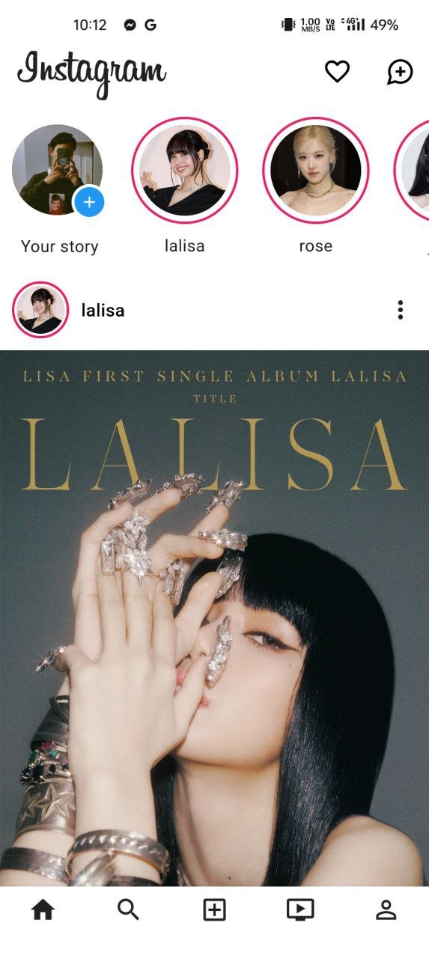
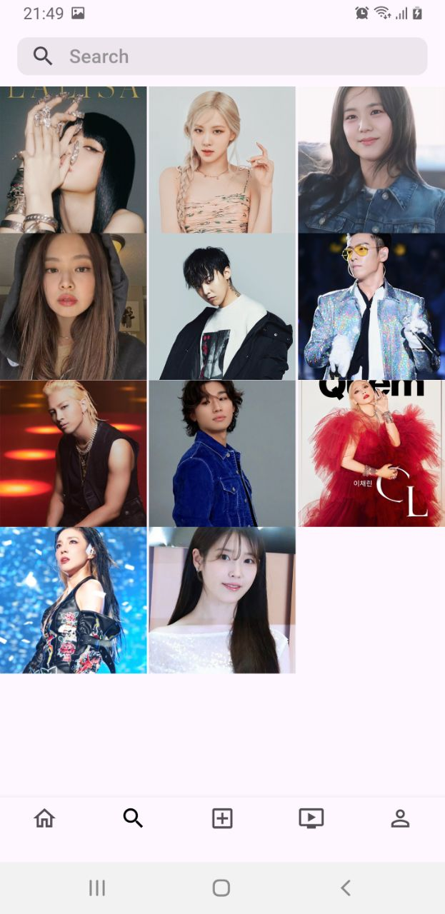
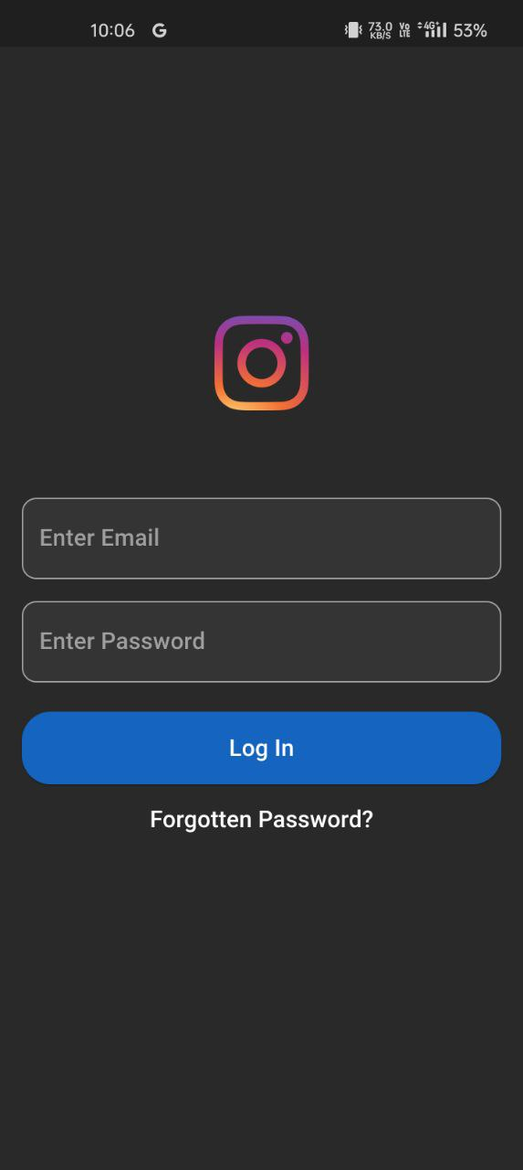
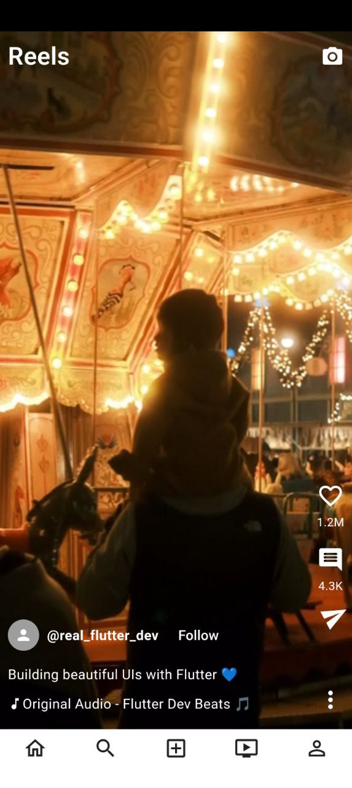
Reels Screen
Important code breakdown
Stateful widget to mane video playback
Overlay: for additional options menu
VideoPlayerController.networkUrl.
ChewieController manages video settings like auto-play and controls.

Slide 10
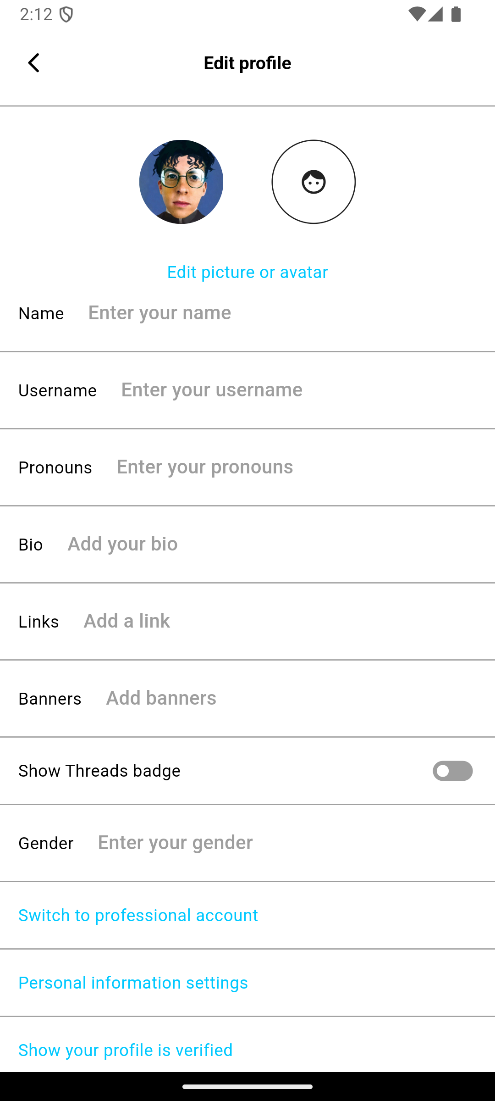
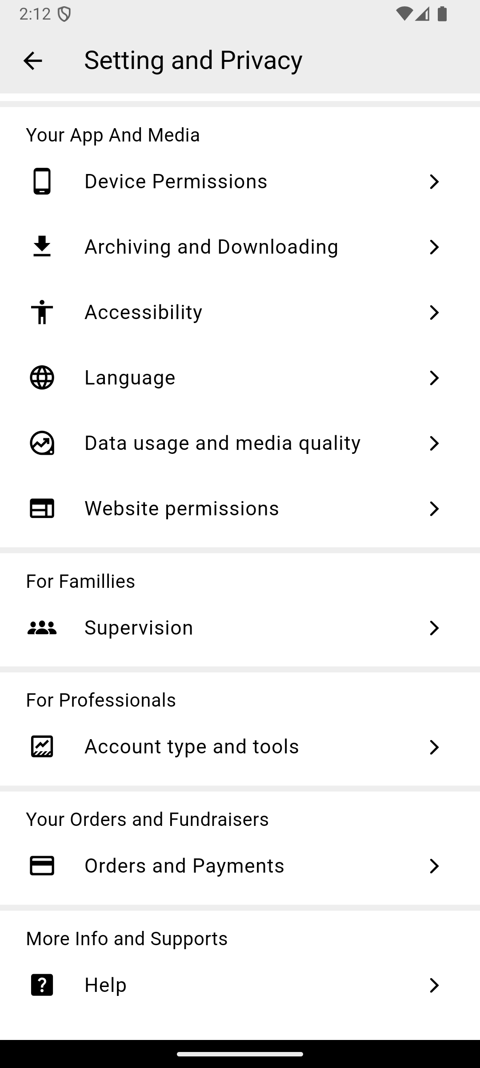
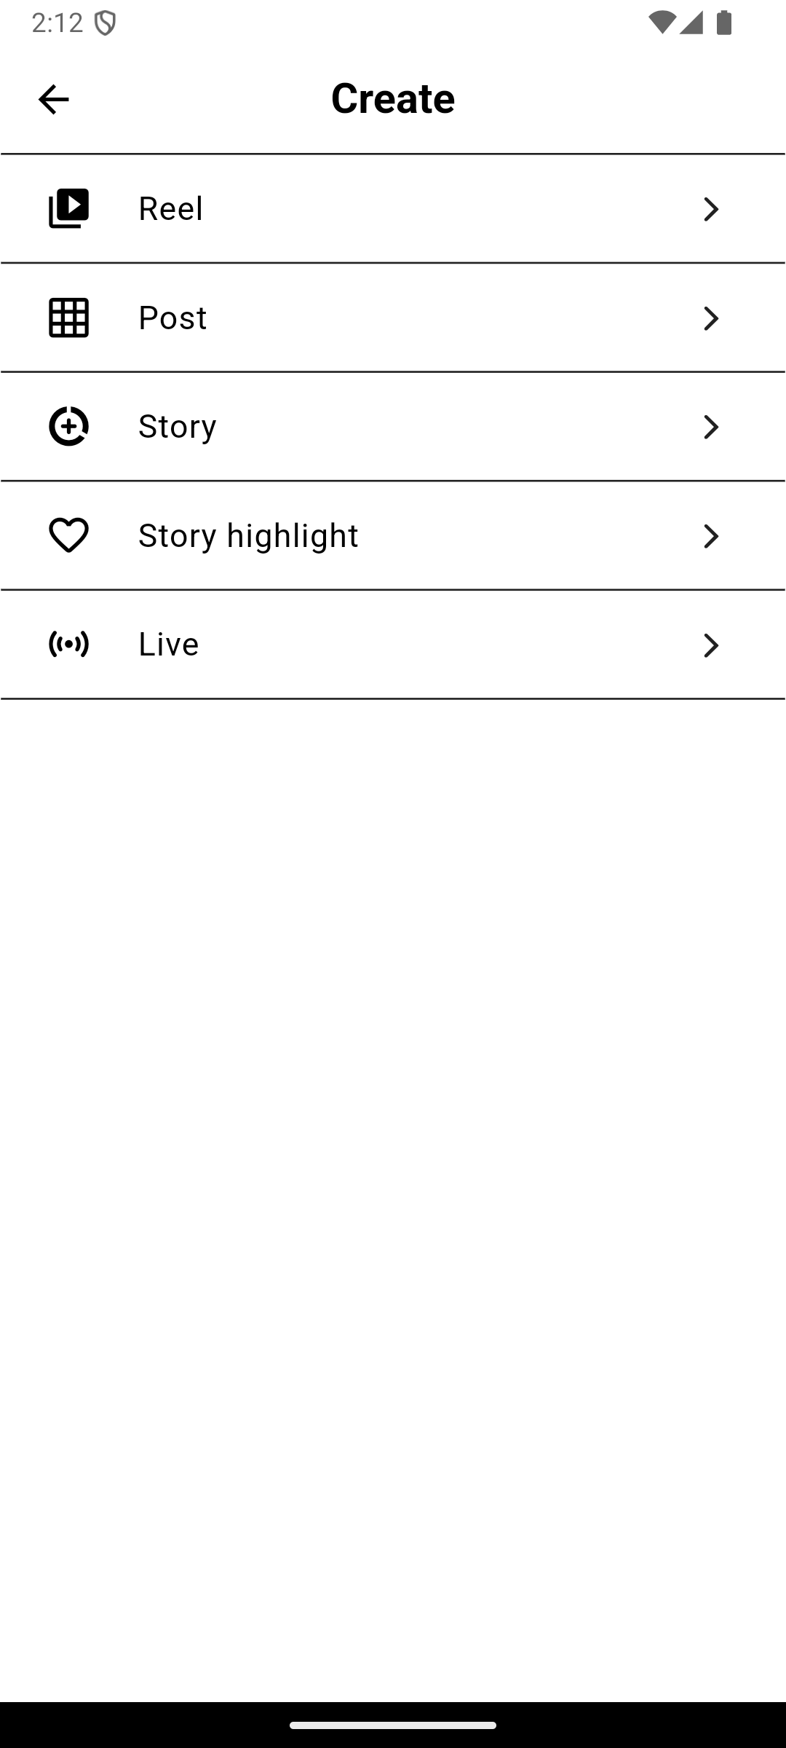
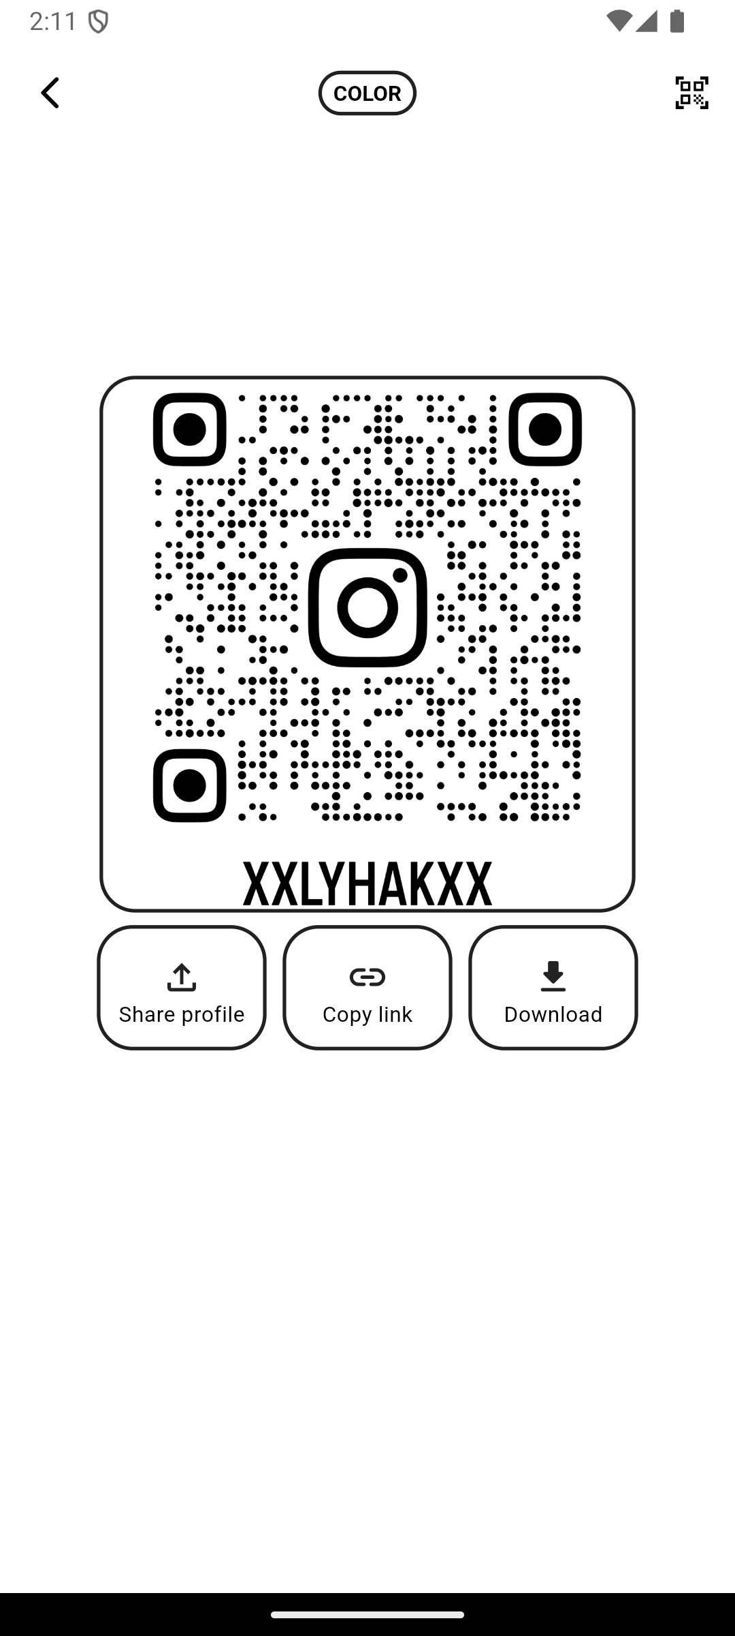
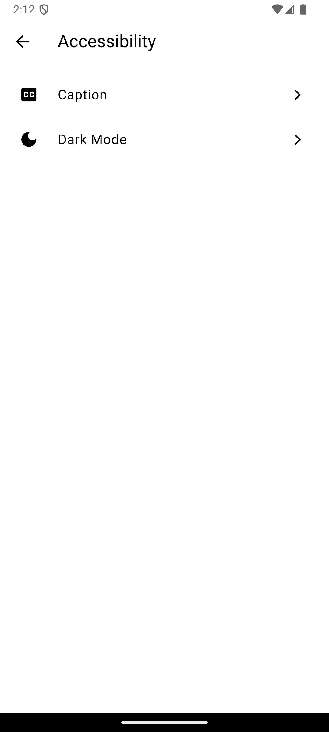
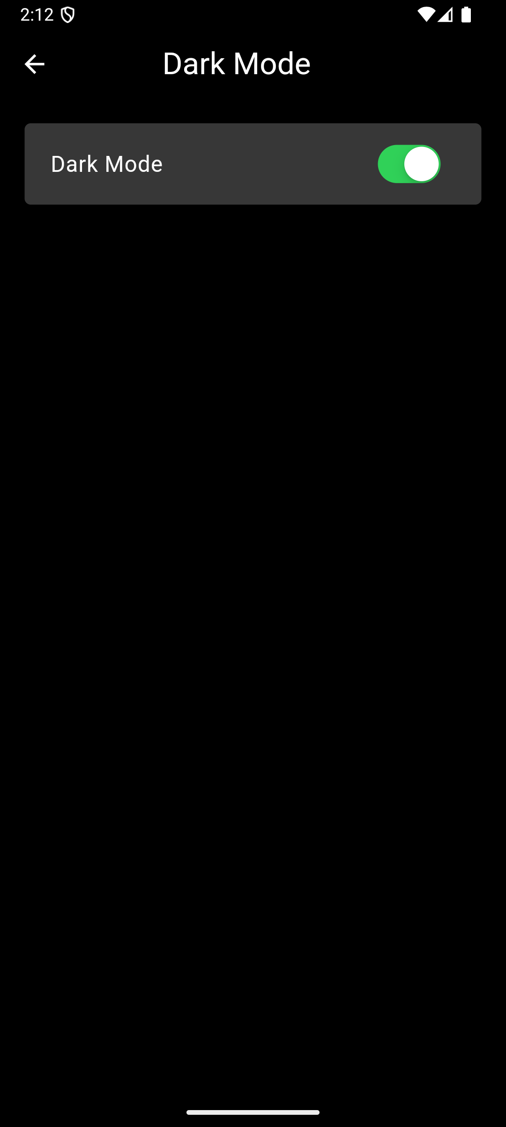
User Profile

Slide 11

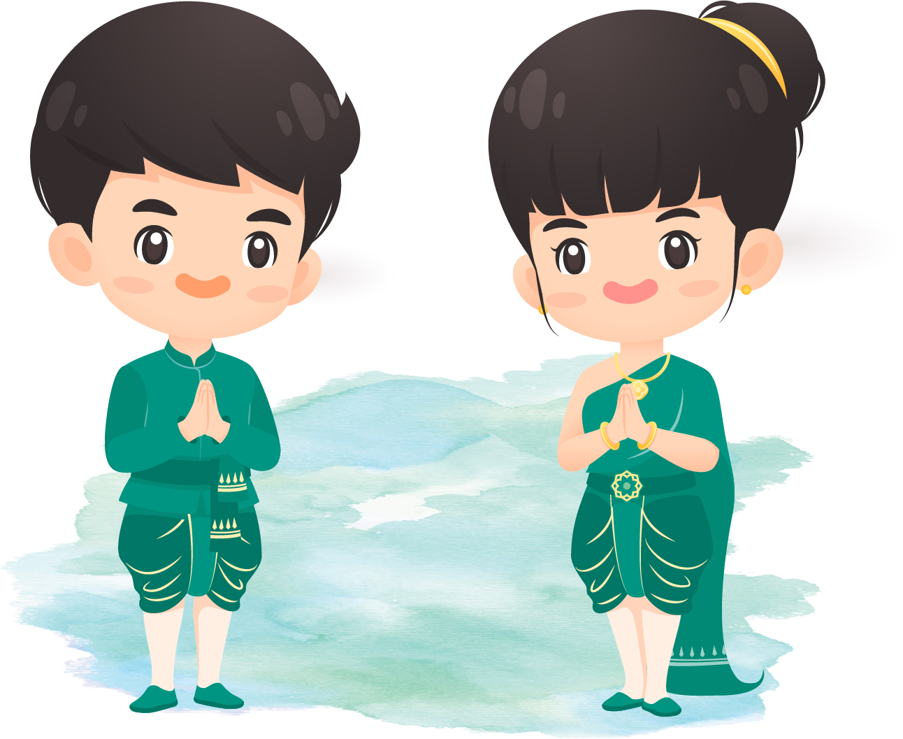
Thank you!

